Slide 1
NASA Web World Wind
This is a GSKY client that is derived from NASA World Wind
ACKNOWLEDGEMENT
This document describes a software that has been derived from an SDK provided by NASA. The SDK is licenced as per the Apache licence and is therefore it is free to modify, use and distribute. However, the source code of the final product is the property of NCI and must not be given out, as it uses a Bing Maps licence key that is not transferable.
Copyright © 2019 by National Computational Infrastructure, Canberra, ACT, Australia.
Author: Dr. Arapaut V. Sivaprasad.
19 March, 2019

Slide 2
INTRODUCTION
Slides 2-5 are for developers. Slide 6-7 are user guide.
Web WorldWind is a free, open-source virtual globe for web pages. Written in JavaScript, Web WorldWind enables web page and application builders to quickly create interactive visualizations of geographic information on an interactive 3D globe or 2D map. Web WorldWind provides an API that enables JavaScript programs to control every detail of visualization and interaction. Web WorldWind runs on all major operating systems, desktop and mobile devices, and web browsers.[^{Ref}]
Download
All source code is open source for developers throughout the world. Fork the repository on GitHub!
Software Architecture
The software is composed of a HTML front-end page and several JavaScript files. These JS files control every aspect of the operation and are portable to any machine running a web server. There are external calls to NASA’s (and others’) servers to get the images, maps and layers that go into the display. These cannot be altered without breaking the program.
Integration with GSKY
Any WMS service can be implemented by providing its URL (e.g. GSKY: https://gsky.nci.org.au/ows/geoglam) and configuring the layers. These layers are hard coded within the main JS file and hence the users do not have to type in the URL as in the case of other GSKY clients. The page will display the layers as a list to choose from.
Typically, the published URL will be similar to the one below.
http://130.56.242.19/NASA/WorldWind/geoglam.html
Next: Technical Details

Slide 3
Technical Details
Repository: https://github.com/asivapra/WebWorldWind
Requirements:
A webserver listening on port 80 or 443
Any other port is fine too, as long as it is specified in the URL.
HTML5 canvas capability for the browser.
Javascript enabled on browser.
Main Pages:
geoglam.html
geoglam.js
dea.html
dea.js
Main Directories:
/src
/examples
/images
Required Configs:
Base map
Base layers
Controls
GSKY layers
/src
WorldWindow.js
util/BingImageryUrlBuilder.js
/examples
WorldWindShim.js
LayerManager.js
Next: Steps to Build
DISCLAIMER
The list of files and configs shown here are not exhaustive. There are many other files involved, but they are not required to be modified.

Slide 4
Steps to Build the Web App
STEPS
Customise the front page.
Edit the main JS file.
Upload both to the $htmlRootdir/NASA/WorldWind dir.
Use the URL as e.g. http://130.56.242.19/NASA/WorldWind/dea.html
2a. Edit the main JS file (contd…)
Duplicate the following code block for each layer. Increment the layername each time.
var createLayer1 = function (xmlDom) {
var wms = new WorldWind.WmsCapabilities(xmlDom);
var wmsLayerCapabilities = wms.getNamedLayer(layerName1);
var wmsConfig = WorldWind.WmsLayer.formLayerConfiguration(wmsLayerCapabilities);
wmsConfig.title = layerTitle1; // Title does not have to match in Capabilities
var wmsLayer = new WorldWind.WmsLayer(wmsConfig);
wmsLayer.enabled = true;
wwd.addLayer(wmsLayer);
layerManager.synchronizeLayerList();
};
1. Customise the front page
There is nothing much to do here except specifying the Javascript file.
The word in red below tells which Javascript file is to be used (dea.js)
<script data-main=“dea" …></script>
Specify a destination place here, if you wish. It can be omitted.
Using “Alice Springs” to center the map on Australia when double clicked.
<input … placeholder="GoTo" id="searchText" value=“Alice Springs"/>
2b. Edit the main JS file (contd…)
Insert the following lines for each layer.
$.get(serviceAddress1).done(createLayer1).fail(logError);
$.get(serviceAddress1).done(createLayer2).fail(logError);
2. Edit the main JS file
Add the code below to centre the map on Australia:
wwd.navigator.lookAtLocation.latitude = -26;
wwd.navigator.lookAtLocation.longitude = 134;
wwd.navigator.range = 8e6; // Camera is 8km above the Earth
wwd.redraw();
Add the URL of the GSKY server and the layers required.
var serviceAddress1 = "https://gsky.nci.org.au/ows/dea?SERVICE=WMS&REQUEST=GetCapabilities&VERSION=1.3.0";
var layerName1 = "landsat5_geomedian"; // This must match exactly as in Capabilities
var layerName2 = "landsat5_nbar_16day";
etc.
var layerTitle1 = "LS5 surface reflectance geomedian";
var layerTitle2 = "16D LS5 surface reflectance (NBAR)";
3. Upload the dea.html and dea.js to $htmlRootdir/NASA/WorldWind
4. Now, this URL will find the map page.
http://130.56.242.19/NASA/WorldWind/dea.html
DISCLAIMER
To be quick, without having to explore all dependencies and subdirs called by the Javascripts, the build was created in the /examples directory of the priginal Git repo. In the production environment it is recommended to move the files from the examples directory which contains several other scripts that are not required.
Next: Publish

Slide 5
Publish the Web App
If there is a webserver listening on port 80 or 443 it is a simple matter of cloning the following GitHub repo under your HTTP root directory.
https://github.com/asivapra/NASA
The Web App can be accessed by: http://www.yourserver.com/NASA/WorldWind/dea.html
See the previous slide to know how to create the GSKY Web App.
If there is no publicly facing webserver on your Linux machine, you can start a minimal webserver using Python as below.
For Python 2.x:
python -m SimpleHTTPServer&
For Python 3.x:
python -m http.server
In both cases the webserver will listen on port 8000. Unless this port is open to the world you will have to create an SSH tunnel to access the page. See slide 9 in GSKY-Thredds_Integration.pptx to learn about port forwarding.
While the http server is running and the SSH tunnel is open, you can view the web at: http://localhost:8000/NASA/WorldWind/dea.html.
Next: User Guide

Slide 6
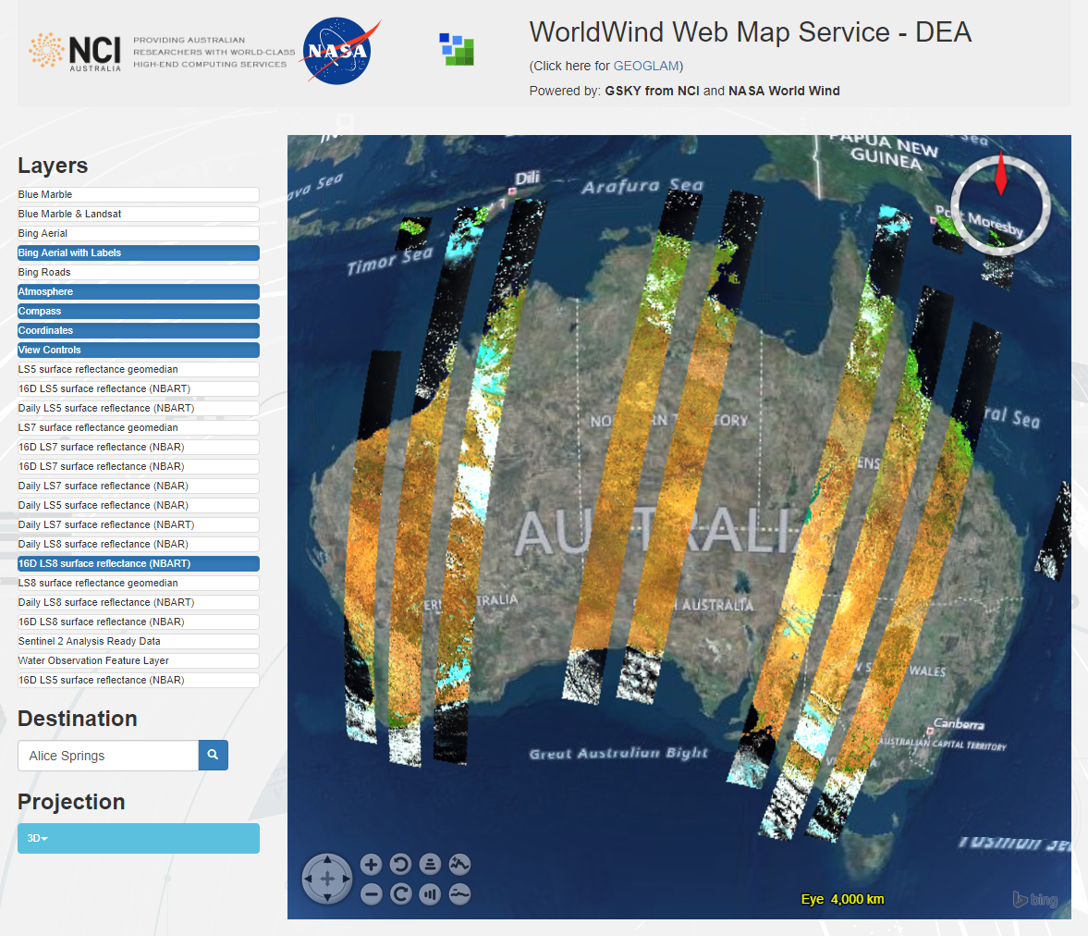
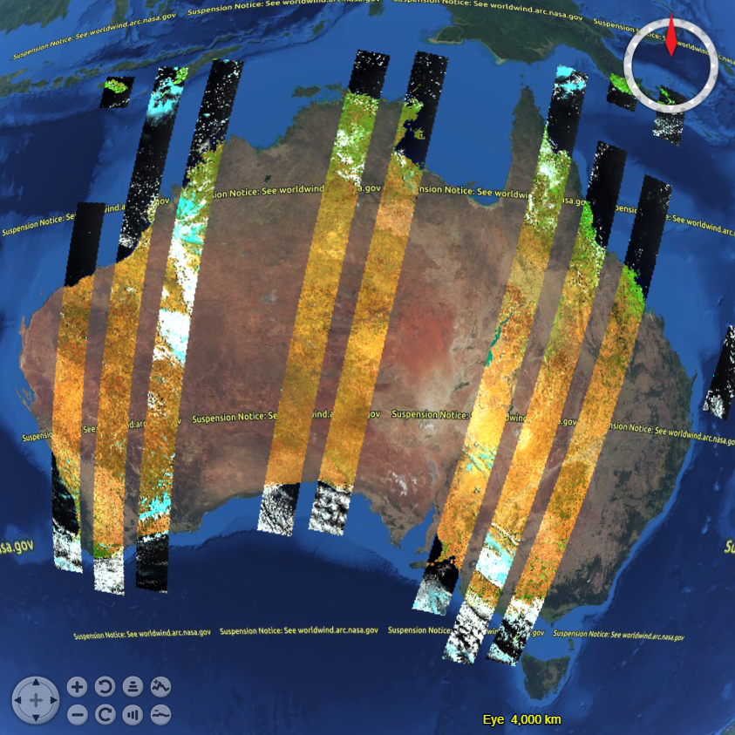
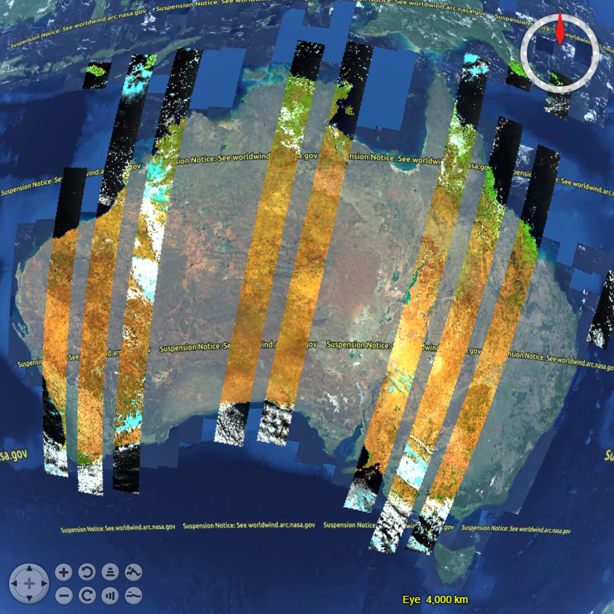
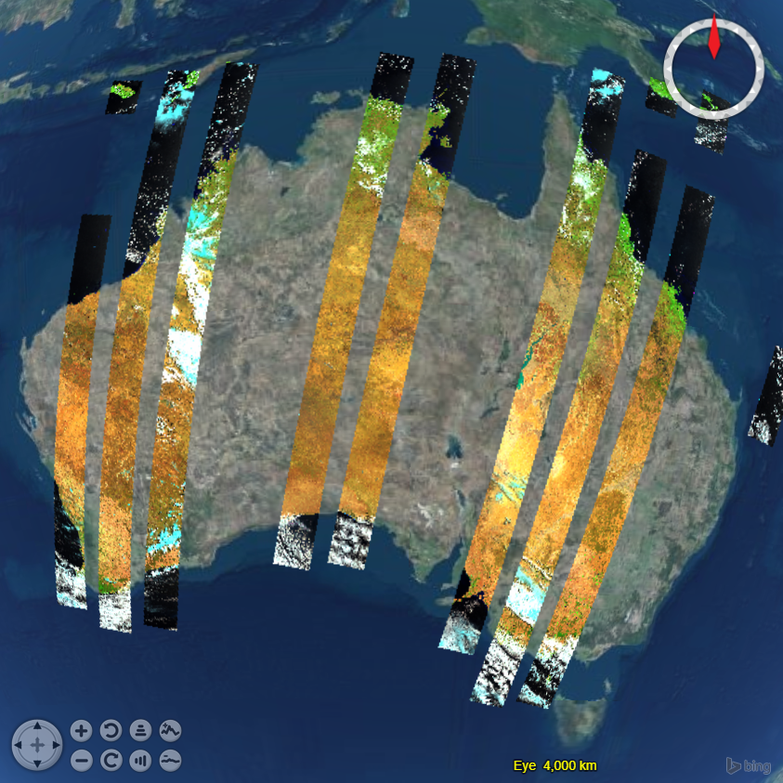
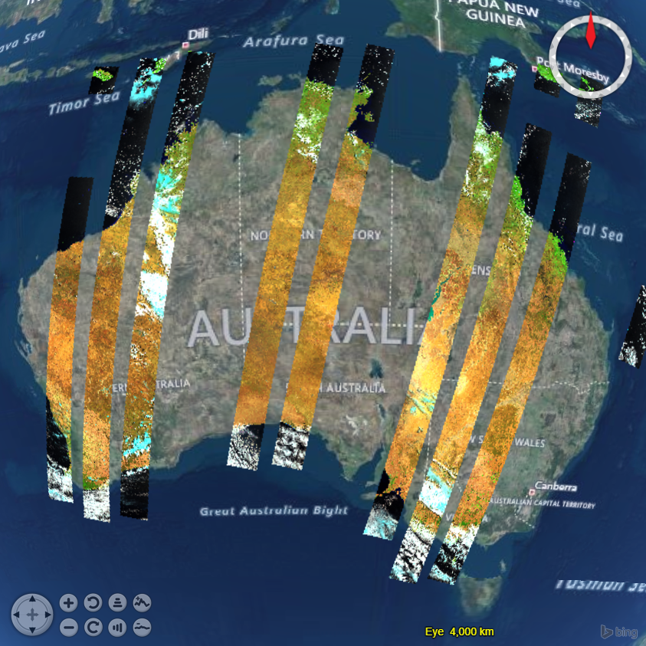
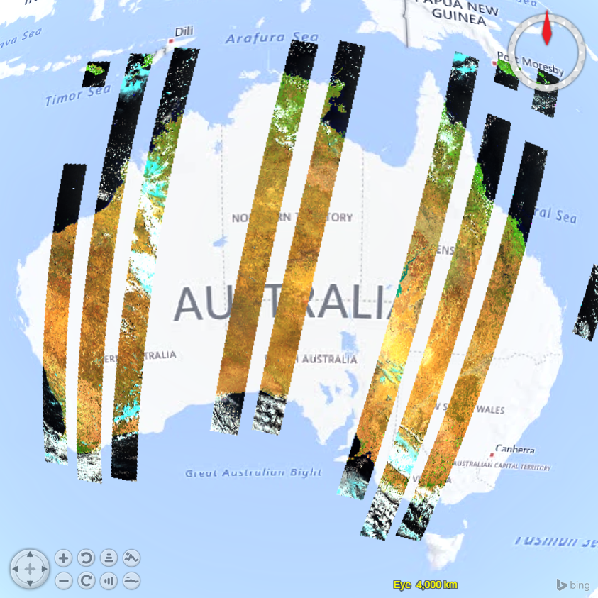
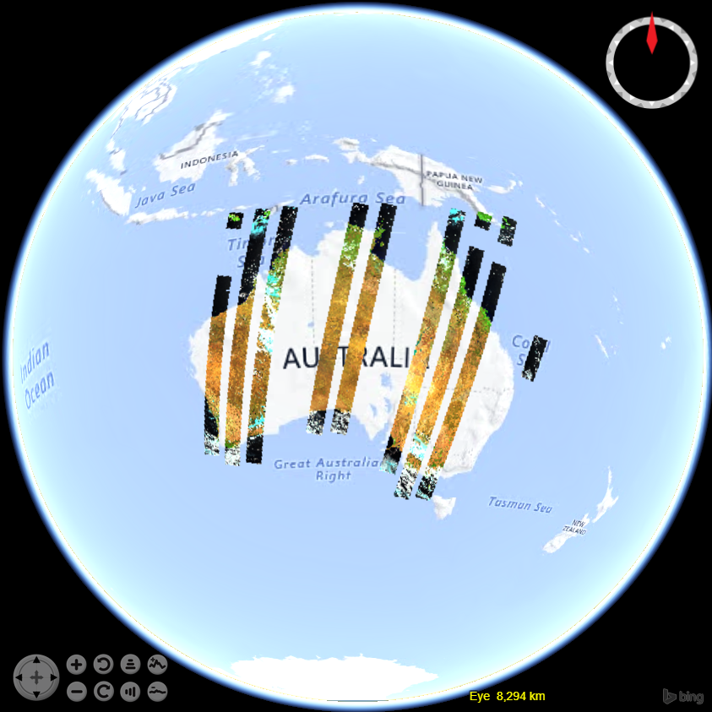
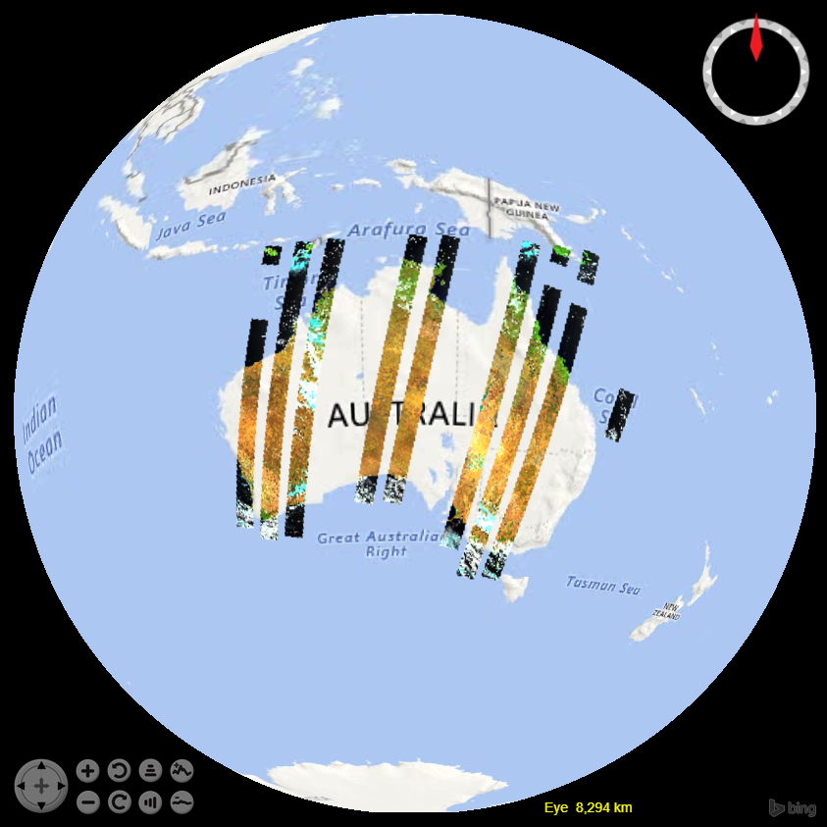
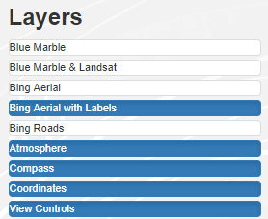
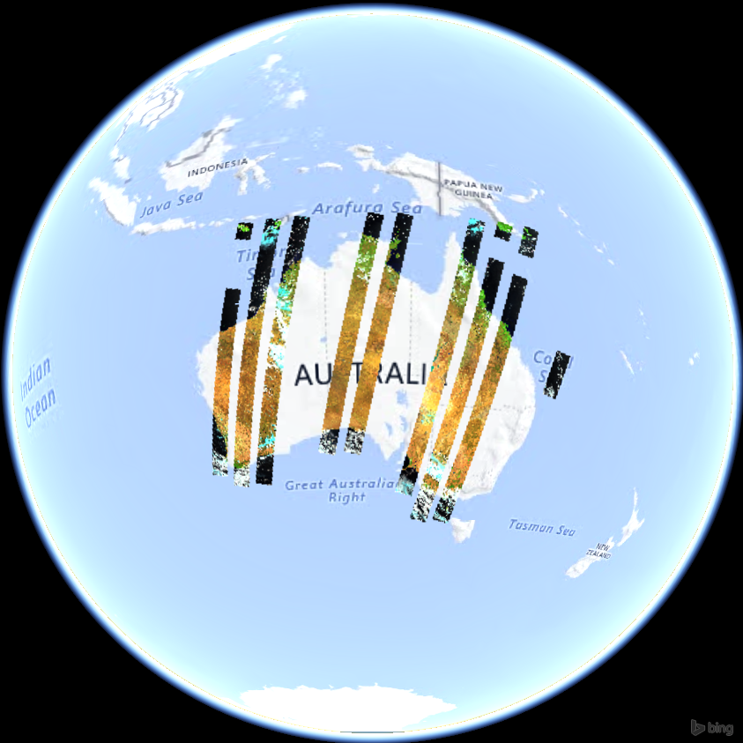
User Guide
This slide must be viewed as a slide show to see all elements.
The Web App
Next: DEA Layers
Notes:
NASA is discontinuing, on 3 May 2019, the servers that provide some data and maps. This means the top two layers, ‘Blue Marble’ and ‘ Blue Marble and Landsat’ will become inactive. The maps provided by Bing are expected to remain. It is required to test the functionality after the service suspension.

Slide 7
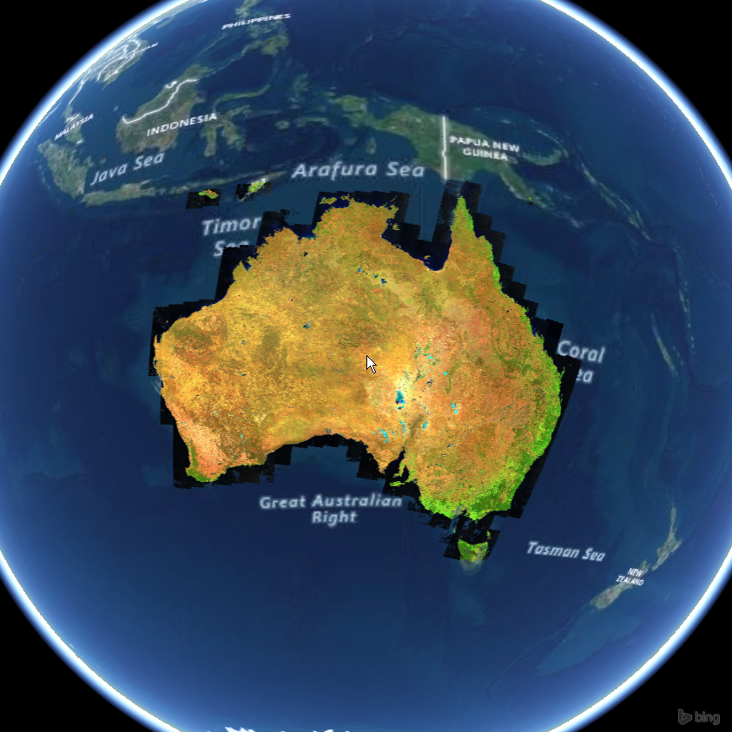
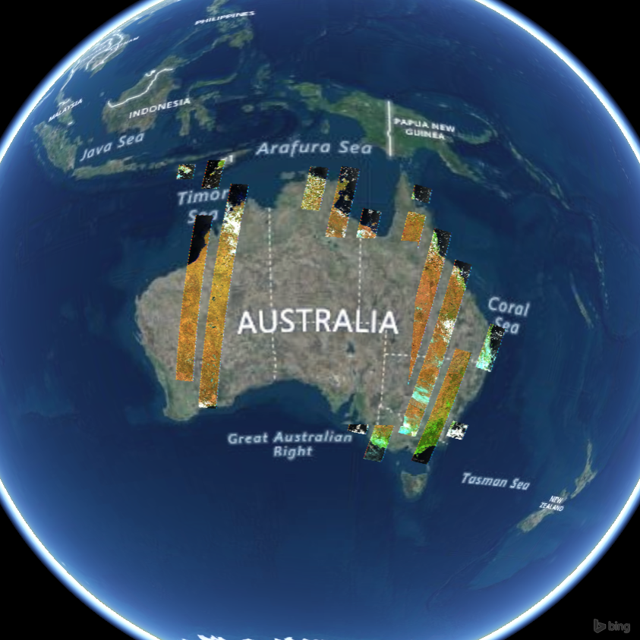
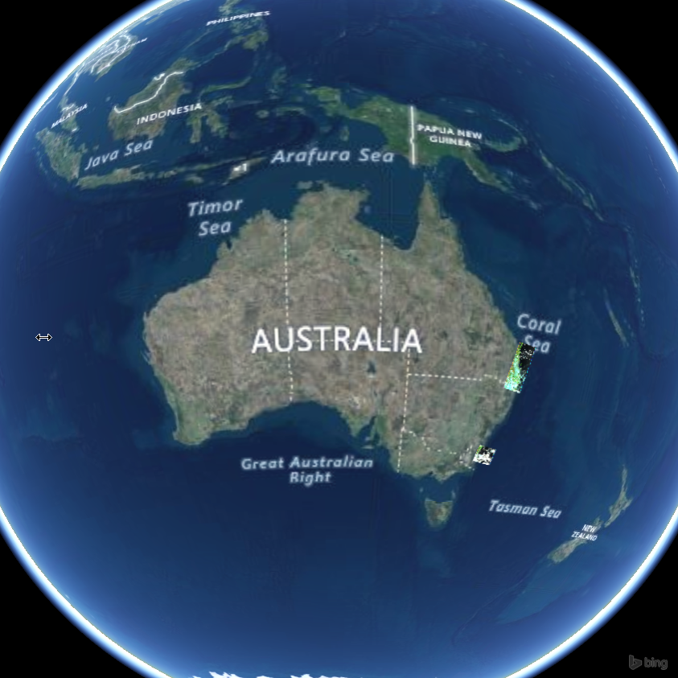
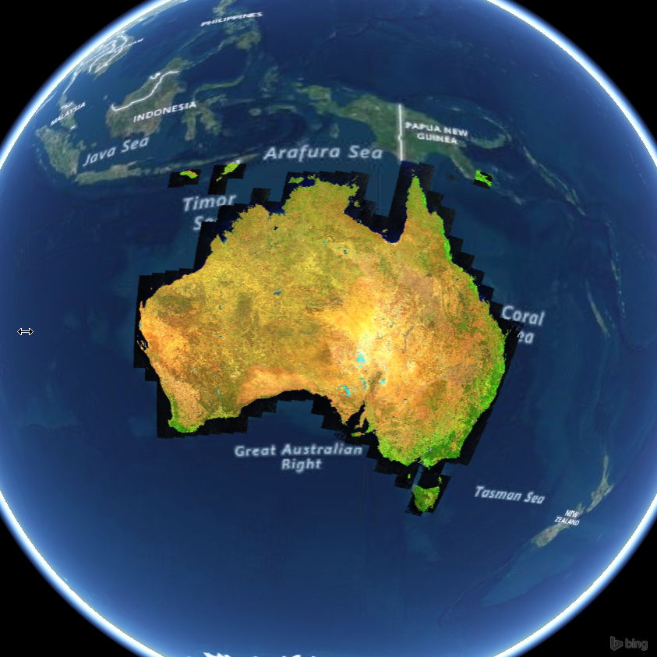
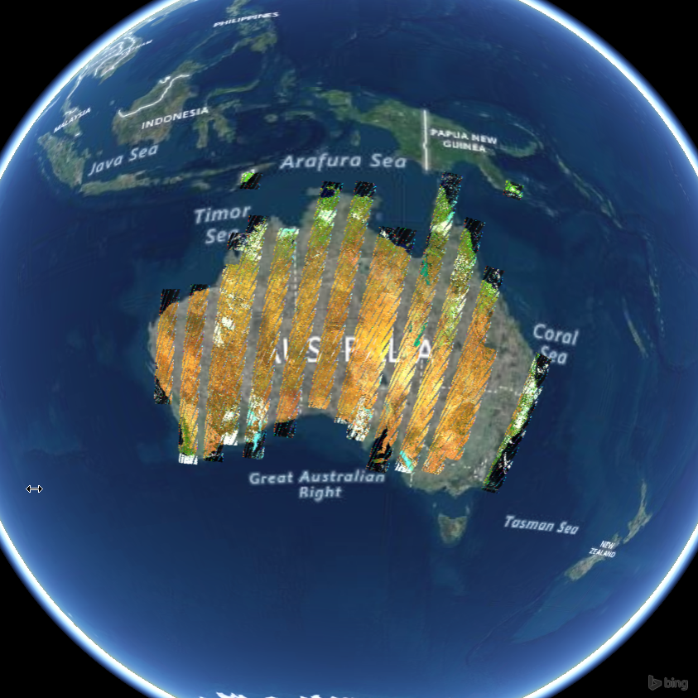
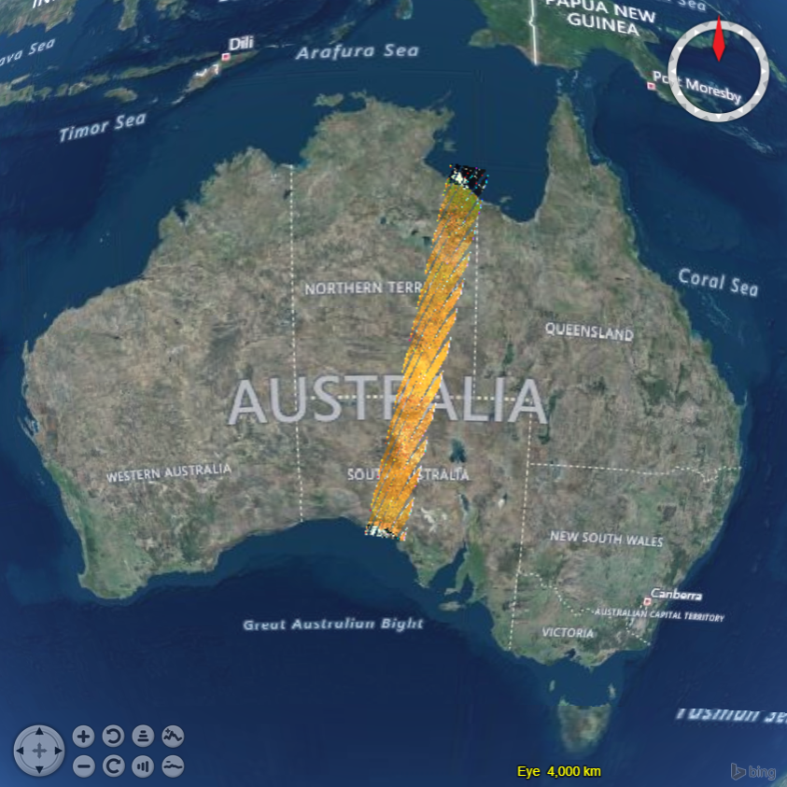
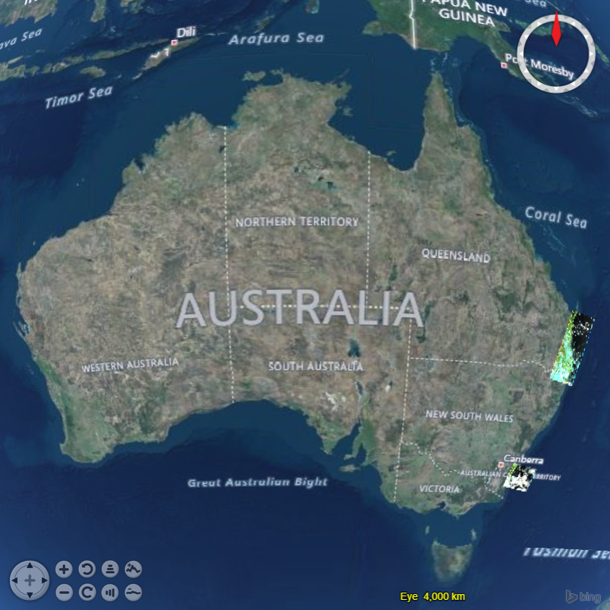
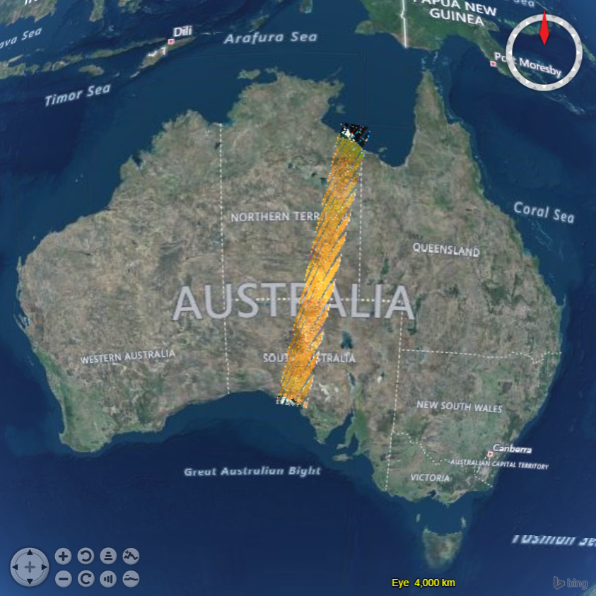
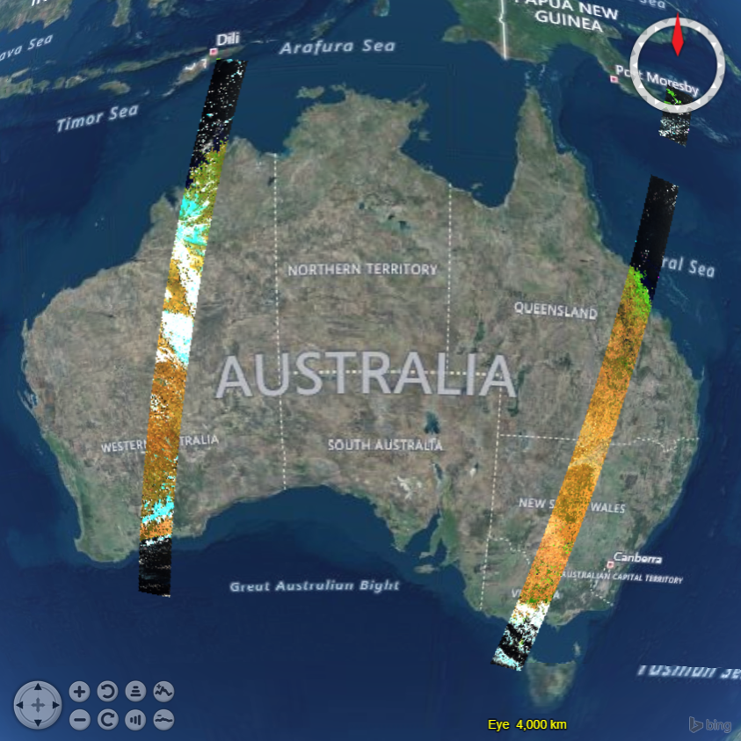
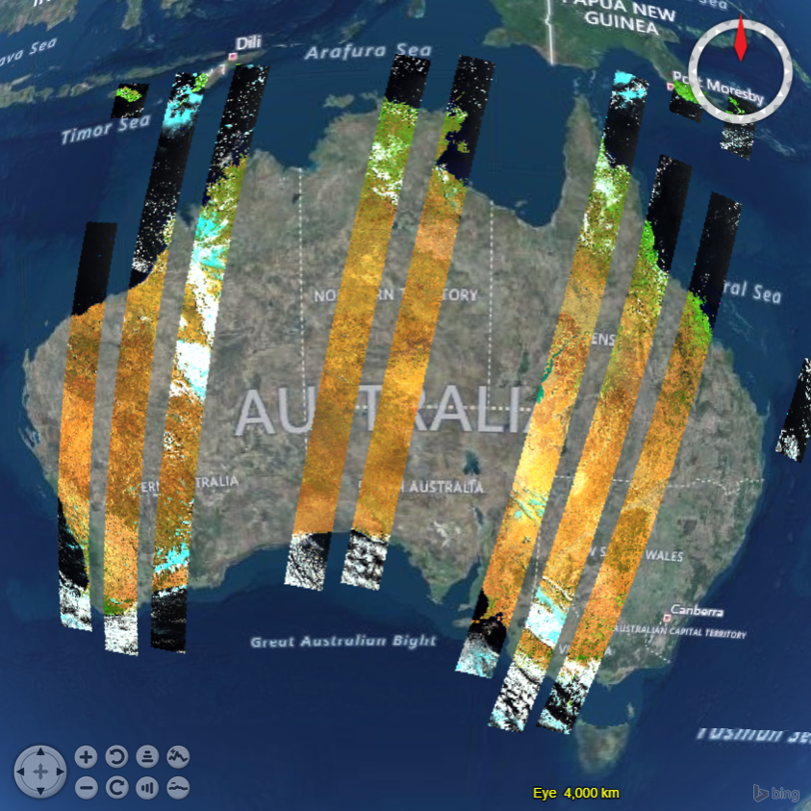
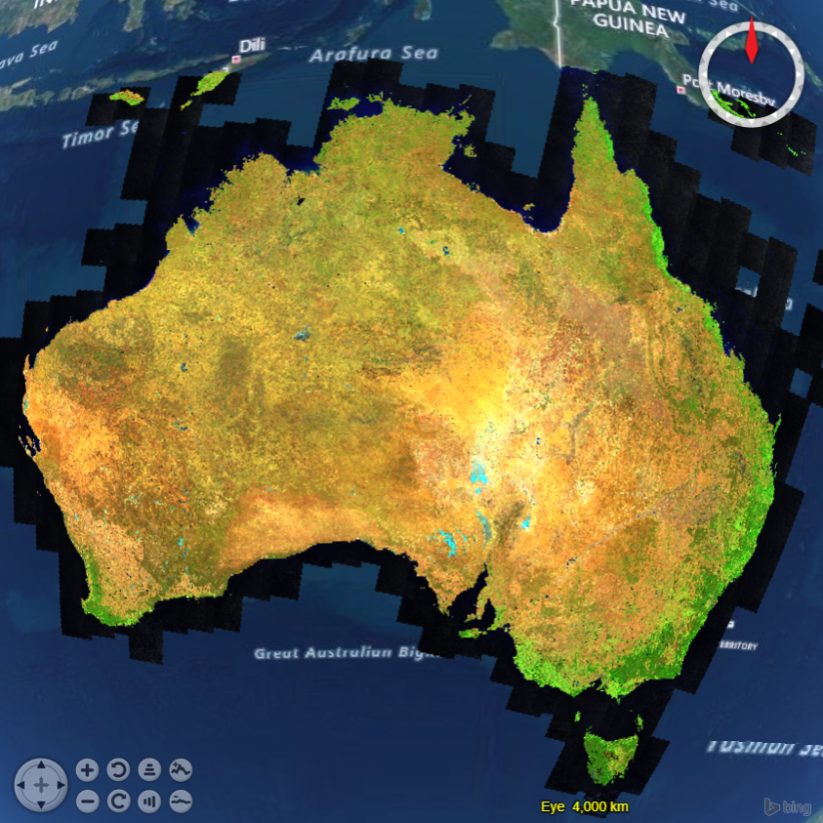
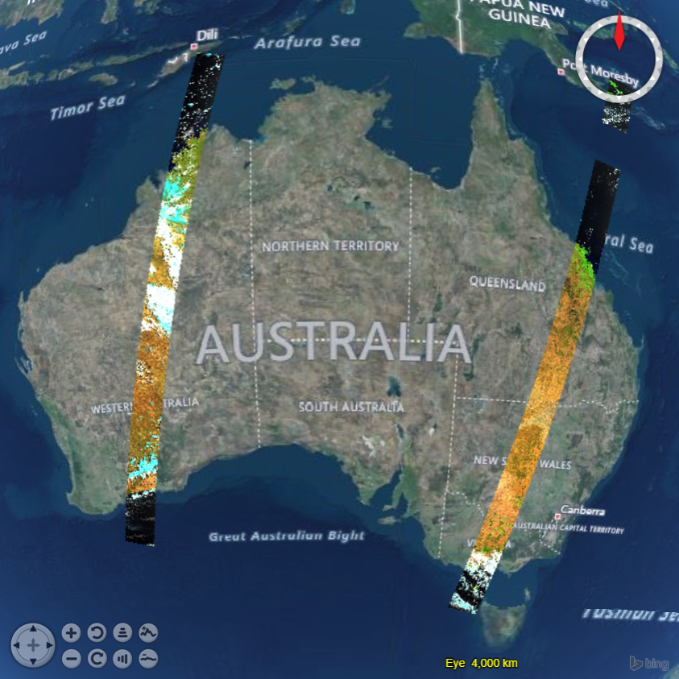

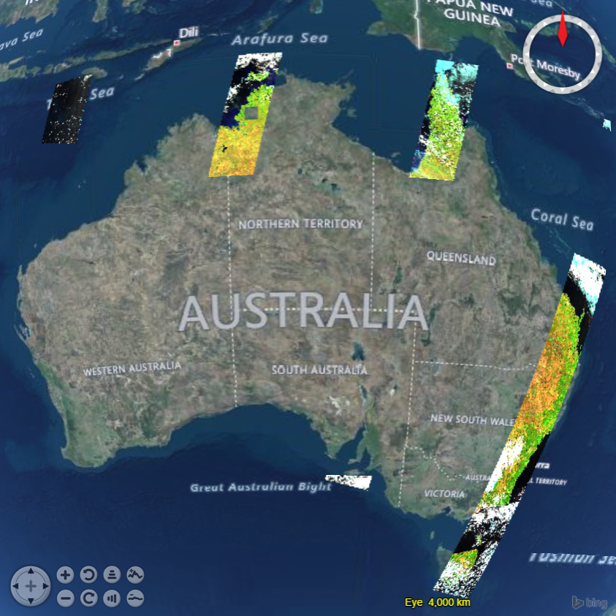
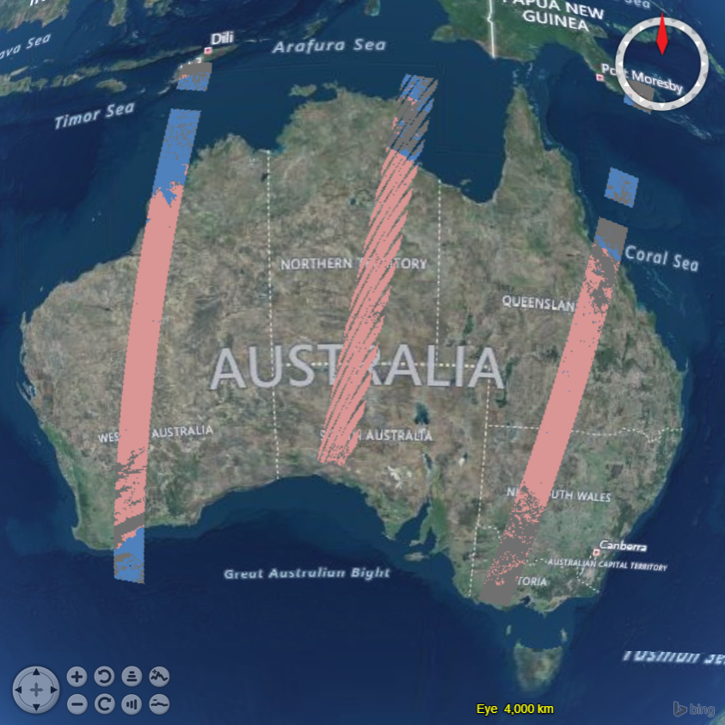
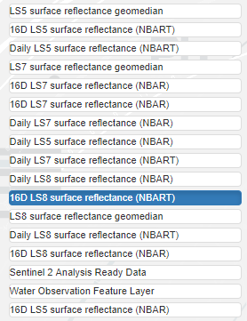
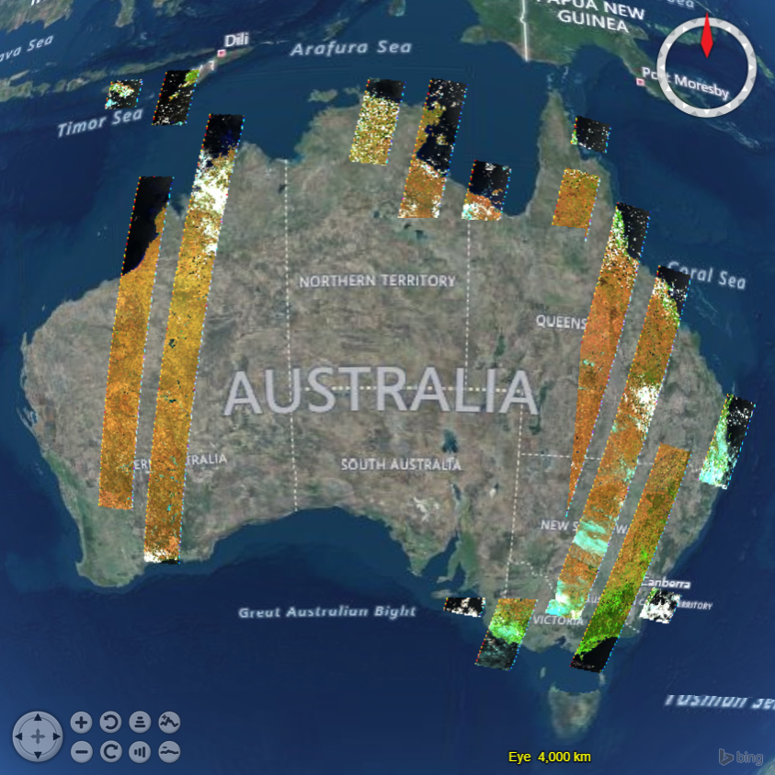
User Guide
This slide must be viewed as a slide show to see all elements.
The Web App
Next: DEA Layers
Notes:
NASA is discontinuing, on 3 May 2019, the servers that provide some data and maps. This means the top two layers, ‘Blue Marble’ and ‘ Blue Marble and Landsat’ will become inactive. The maps provided by Bing are expected to remain. It is required to test the functionality after the service suspension.

Slide 8
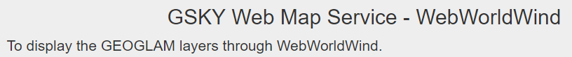
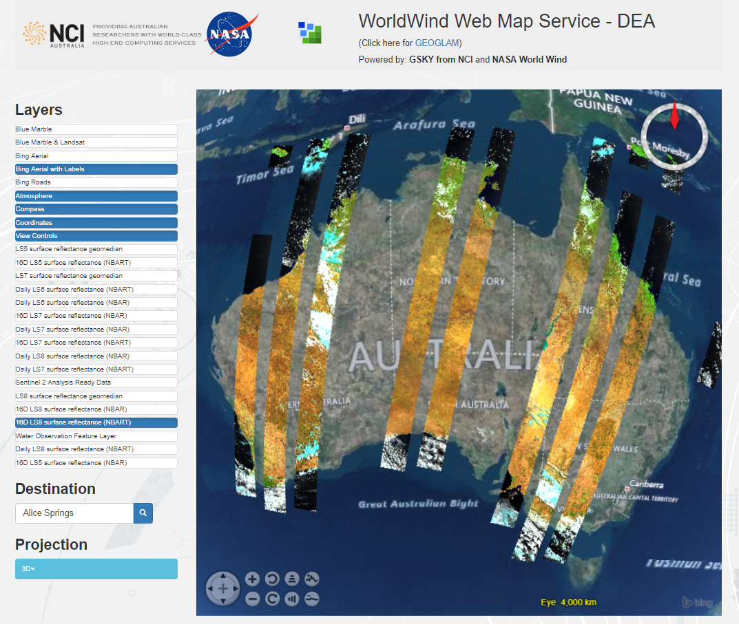

User Guide
Additional Controls
1. Web App: http://www.webgenie.com/NCI_WorldWind/gsky/geoglam.html
4. Pan the map
5. Zoom in/out
6. Rotate left/right
7. Tilt up/down
8. Unknown function!
Next: Advanced Settings

Slide 9






Acknowledgements

